Slide 1
Carfilzomib, Lenalidomide, and Dexamethasone vs Lenalidomide and Dexamethasone in Patients With Relapsed Multiple Myeloma: Interim Results From ASPIRE, a Randomized, Open-Label, Multicenter Phase III Study
Stewart AK, Rajkumar SV, Dimopoulos MA, Masszi T, Spicka I, Oriol A, Hájek R, Rosiñol L, Siegel DS, Mihaylov GG, Goranova-Marinova, V, Rajnics P, Suvorov A, Niesvizky R, Jakubowiak A, San Miguel JF, Ludwig H, Zojwalla N, Tonda ME, Xing B, Moreau P, and Palumbo A
Abstract #79

Slide 2
Background
Lenalidomide plus high-dose dexamethasone (RD) is a reference treatment for relapsed multiple myeloma (MM)
Lenalidomide plus weekly dexamethasone (Rd) is less toxic than RD, while yielding similar response rates
Carfilzomib is an epoxyketone proteasome inhibitor approved in the United States as a single agent in relapsed and refractory MM
Carfilzomib, lenalidomide, and weekly dexamethasone (KRd) was well tolerated in phase I/II trials with clinical activity in newly diagnosed and relapsed MM
Stewart AK, et al. Blood. 2014;124: Abstract 79.

Slide 3
ASPIRE: KRd vs Rd
Primary endpoint: progression-free survival (PFS)
Secondary endpoints: overall survival (OS), overall response rate (ORR), duration of response, health-related quality of life, safety
Key inclusion criteria
Symptomatic MM
Measurable disease
1-3 prior treatments
Relapsed or progressive disease
Partial response or better to at least 1 prior regimen
Key exclusion criteria
Creatinine clearance <50 mL/min
Progressive disease (PD) on bortezomib*
If previously treated with Rd:
PD during the first 3 months of treatment
PD at any time if Rd was the most recent treatment
Lenalidomide or dexamethasone intolerance
*If a patient progressed during any bortezomib-containing regimen, they were eligible to enroll if the progression date occurred after discontinuation of bortezomib.
Stewart AK, et al. Blood. 2014;124: Abstract 79.
Notes:
Patients were excluded if they had grade 3 or 4 peripheral neuropathy (grade 2 with pain) within 14 days prior to randomization or New York Heart Association Class III or IV heart failure.

Slide 4
ASPIRE Study Design
28-day cycles
Randomization
N = 792
Stratification:
β₂-microglobulin
Prior bortezomib
Prior lenalidomide
KRd
Carfilzomib 27 mg/m² IV (10 min)
Days 1, 2, 8, 9, 15, 16 (20 mg/m² days 1, 2, cycle 1 only)
Lenalidomide 25 mg days 1–21
Dexamethasone 40 mg days 1, 8, 15, 22
After cycle 12, carfilzomib given on days 1, 2, 15, 16
After cycle 18, carfilzomib discontinued
Rd
Lenalidomide 25 mg days 1–21
Dexamethasone 40 mg days 1, 8, 15, 22
IV, intravenously
Stewart AK, et al. Blood. 2014;124: Abstract 79.

Slide 5
Patient and Disease Characteristics at Baseline Intent-to-Treat (ITT) Population (N = 792)
Characteristic | KRd (n = 396) | Rd (n = 396)
Median age, years (range) ≥65 years, % | 64 (38–87) 46.7 | 65 (31–91) 52.5
ECOG performance status, % 0–1 2 | 89.9 10.1 | 91.2 8.8
Cytogenetic risk category by FISH, % High Standard Unknown | 12.1 37.1 50.8 | 13.1 42.9 43.9
Mean creatinine clearance, mL/min (SD) ≥50 mL/min, % | 85.0 (28.9) 93.4 | 85.9 (30.2) 90.4
Serum β₂-microglobulin ≥2.5 mg/L, % | 80.6 | 80.6
ECOG, Eastern Cooperative Oncology Group; FISH, fluorescence in situ hybridization; SD, standard deviation
Stewart AK, et al. Blood. 2014;124: Abstract 79.

Slide 6
Patient and Disease Characteristics at Baseline (continued) ITT Population (N = 792)
Characteristic | KRd (n = 396) | Rd (n = 396)
Presence of neuropathy at baseline, % | 36.4 | 34.6
Number of prior regimens, median (range) | 2 (1–3) | 2 (1–3)
Prior therapies, % Transplant Bortezomib Refractory to prior bortezomib in any prior regimen* Lenalidomide Any IMiD Refractory to prior IMiD in any prior regimen* Bortezomib and IMiD Refractory to prior bortezomib and IMiD in any prior regimen* | 54.8 65.9 15.2 19.9 58.8 21.5 36.9 6.1 | 57.8 65.7 14.6 19.7 57.8 22.2 35.1 6.8
*Refractory is defined as less than minimal response to or progression during therapy or within 60 days after completion of therapy. If a patient progressed during any bortezomib-containing regimen, they were eligible to enroll if the progression date occurred after discontinuation of bortezomib.
IMiD, immunomodulatory agent
Stewart AK, et al. Blood. 2014;124: Abstract 79.

Slide 7
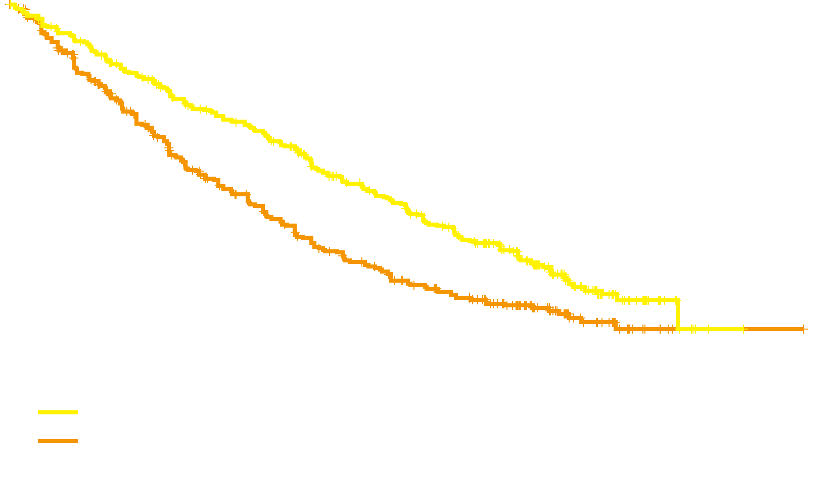
Primary Endpoint: PFS ITT Population (N = 792)
1.0
KRd Rd
(n = 396) (n = 396)
Median PFS, mo 26.3 17.6
HR (KRd/Rd) (95% CI) 0.69 (0.57–0.83)
P value (1-sided) <.0001
0.8
0.6
Proportion Surviving
Without Progression
0.4
0.2
KRd
Rd
0.0
0
6
12
18
24
30
36
42
48
Months Since Randomization
No. at risk:
KRd
Rd
396 332 279 222 179 112 24 1
396 287 206 151 117 72 18 1
Median duration of response was 28.6 months in the KRd group and 21.2 months in the Rd group
CI, confidence interval; HR, hazard ratio.
Stewart AK, et al. Blood. 2014;124: Abstract 79.
Notes:
The cutoff date for the interim analysis was June 16, 2014
In the carfilzomib and control groups, 118 (29.8%) and 86 (21.7%) patients, respectively, were still receiving study treatment
At the time of the prespecified interim analysis, 431 progression-free survival events were observed
The study met its primary objective of demonstrating that carfilzomib improves progression-free survival when administered with lenalidomide and dexamethasone
With an estimated hazard ratio of 0.690 (95% CI, 0.570 to 0.834), the P value (P<0.0001) crossed the prespecified stopping boundary
The primary end point was evaluated using a group sequential design with one interim analysis
In total, 526 progression-free survival events were needed to provide 90% power to detect a 25% reduction in risk of disease progression or death (hazard ratio of 0.75) at a one-sided significance level of 0.025
The interim analysis was to be performed when approximately 420 progression-free survival events (80% of the planned total) were observed
An O’Brien–Fleming type of efficacy stopping boundary was calculated using the Lan–DeMets alpha spending function approach based on the number of events observed at the data cutoff date

Slide 8
Primary Endpoint: PFS by Subgroup
KRd Rd Intent-to-treat group (n) (n)
Overall 396 396
Subgroup
Age, years
18–64 211 188
≥65 185 208
Risk group by FISH
High risk 48 52
Standard risk 147 170
ß₂ microglobulin, mg/L
<2.5 68 71
≥2.5 324 319
Prior treatment with bortezomib
No 135 136
Yes 261 260
Prior treatment with lenalidomide
No 317 318
Yes 79 78
Refractory to bortezomib in any prior regimen
No 336 338
Yes 60 58
Refractory to immunomodulatory agent in prior regimen
No 311 308
Yes 85 88
HR (95% CI)
0.25
0.50
0.75
1.00
1.25
1.50
1.75
Stewart AK, et al. Blood. 2014;124: Abstract 79.
HR
Favors KRd
Favors Rd
Notes:
The progression-free survival benefit in the carfilzomib group was observed across all predefined subgroups
Patients were nonresponsive (less than minimal response) to any bortezomib-containing regimen, progressed during any bortezomib-containing regimen, or progressed within 60 days of completion of any bortezomib-containing regimen. If a patient progressed during any bortezomib-containing regimen, they were eligible to enroll if the progression date occurred after discontinuation of bortezomib.

Slide 9
PFS by Risk Group
 | KRd (n = 396) |  | Rd (n = 396)
Risk group by FISH | N | Median, months | N | Median, months | HR | P value (1-sided)
High | 48 | 23.1 | 52 | 13.9 | 0.703 | .0829
Standard | 147 | 29.6 | 170 | 19.5 | 0.656 | .0039
Stewart AK, et al. Blood. 2014;124: Abstract 79.
Notes:
Subgroup analysis of PFS as determined by IRC; ITT population

Slide 10
Secondary Endpoints: Response ITT Population (N = 792)
P<.0001
P<.0001
Percentage of Patients
≥CR
P<.0001
Mean time to response was 1.6 months in the KRd group and 2.3 months in the Rd group
CR, complete response; ORR, overall response rate; PR, partial response; sCR, stringent complete response; VGPR, very good partial response
Stewart AK, et al. Blood. 2014;124: Abstract 79.

Slide 11
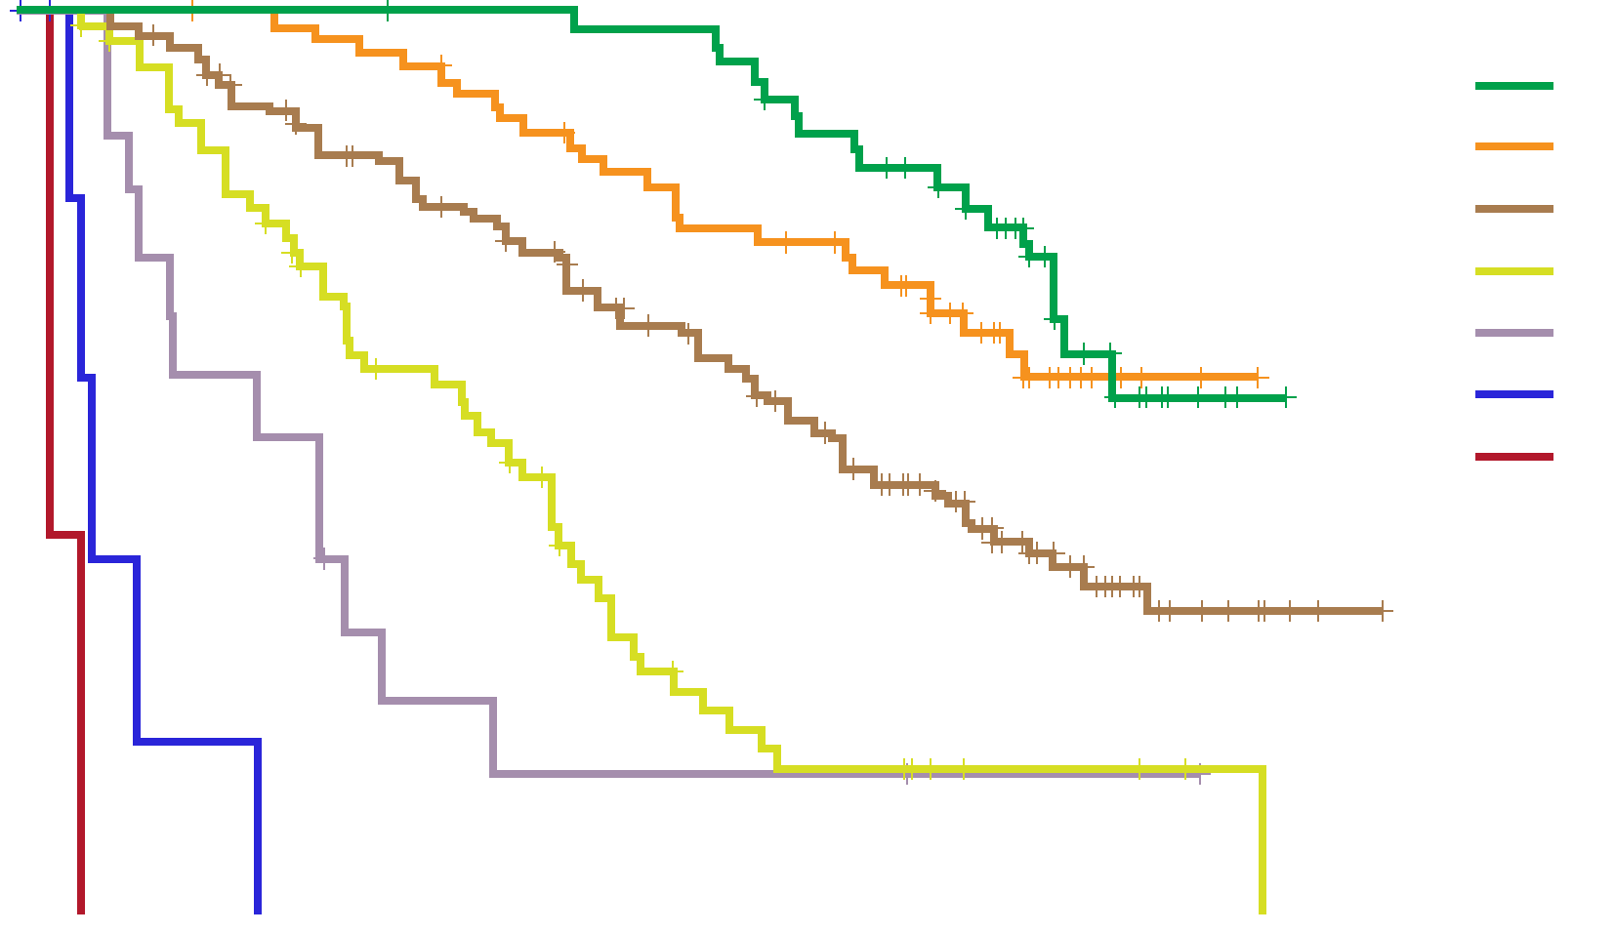
PFS by Response Category, in the KRd Group
+ Censored
1.0
sCR
CR
VGPR
PR
MR
SD
PD
0.8
0.6
Survival Probability
0.4
0.2
0.0
0
10
20
30
40
50
Time From Randomization (Months)
MR, minimal response; SD, stable disease
Stewart AK, et al. Blood. 2014;124: Abstract 79.
Notes:
Kaplan-Meier estimate of progression-free survival in the carfilzomib group was also obtained by response status using a naïve analysis approach (i.e., in which no bias adjustment was made). Caution is warranted when interpreting the naïve analysis due to the absence of adjustment for bias.

Slide 12
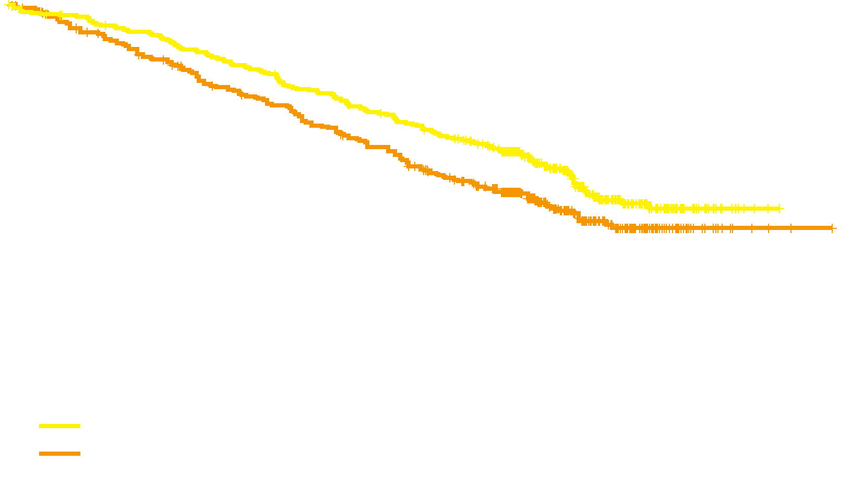
Secondary Endpoints: OS ITT Population (N = 792)
1.0
KRd Rd
(n = 396) (n = 396)
Median OS, mo NE NE
HR (KRd/Rd) (95% CI) 0.79 (0.63–0.99)
P value (1-sided) .018
0.8
0.6
Proportion Surviving
0.4
0.2
KRd
Rd
0.0
0
6
12
18
24
30
36
42
48
Months Since Randomization
No. at risk:
KRd
Rd
396 369 343 315 280 191 52 2
396 356 313 281 237 144 39 3
Median OS was not reached; results did not cross the prespecified stopping boundary at the interim analysis
Kaplan-Meier 24-month OS rates were 73.3% with KRd and 65.0% with Rd
Stewart AK, et al. Blood. 2014;124: Abstract 79.
Notes:
Since the primary objective was met, an interim analysis of overall survival was carried out.
Using the same cutoff date, 305 events had occurred (60% of the prespecified 510 events required for final analysis)
Median follow-up was 32.3 and 31.5 months in the carfilzomib and control groups
Median overall survival was not reached in either group, with a hazard ratio of 0.787 (95% CI, 0.628 to 0.985; P=0.0182) trending in favor of the carfilzomib group
However, these results did not cross the prespecified stopping boundary (P=0.005) for overall survival at the interim analysis
The Kaplan–Meier 24-month overall survival rates were 73.3% (95% CI, 68.6 to 77.5) and 65.0% (95% CI, 59.9 to 69.5) in the carfilzomib and control groups, respectively
The unadjusted P value from the stratified log-rank test comparing the overall survival curves up to 2 years was 0.0046

Slide 13
Adverse Events (AEs), Treatment Discontinuations, and Deaths Safety Population (n = 781)
Category | KRd (n = 392) | Rd (n = 389)
Any AE, % Grade ≥3 treatment-emergent AE | 96.9 83.7 | 97.2 80.7
Deaths within 30 days of last dose, % Deaths due to disease progression Deaths due to AEs | 7.7 0.5 6.9 | 8.5 1.3 6.9
Serious AE, % | 59.7 | 53.7
Median treatment duration, weeks | 88.0 | 57.0
Treatment discontinuations, % Discontinuation due to disease progression Discontinuation due to AE | 69.9 39.8 15.3 | 77.9 50.1 17.7
Stewart AK, et al. Blood. 2014;124: Abstract 79.
Notes:
Adverse events leading to more than two deaths in either group were
Myocardial infarction (carfilzomib, n=3; control, n=1)
Cardiac failure (carfilzomib, n=1; control, n=3)
Sepsis (carfilzomib, n=3; control, n=2)
Fourteen deaths were reported as treatment-related
6 in the carfilzomib group
8 in the control group

Slide 14
AEs Occurring in ≥25% of Patients in Either Arm Safety Population (n = 781)
AE, % | KRd (n = 392) |  | Rd (n = 389)
 | All Grade | Grade ≥3 | All Grade | Grade ≥3
Hematologic AEs
Anemia | 42.6 | 17.9 | 39.8 | 17.2
Neutropenia | 37.8 | 29.6 | 33.7 | 26.5
Thrombocytopenia | 29.1 | 16.6 | 22.6 | 12.3
Stewart AK, et al. Blood. 2014;124: Abstract 79.

Slide 15
AEs Occurring in ≥25% of Patients in Either Arm (continued) Safety Population (n = 781)
AE, % | KRd (n = 392) |  | Rd (n = 389)
 | All Grade | Grade ≥3 | All Grade | Grade ≥3
Nonhematologic AEs
Diarrhea | 42.3 | 3.8 | 33.7 | 4.1
Fatigue | 32.9 | 7.7 | 30.6 | 6.4
Cough | 28.8 | 0.3 | 17.2 | 0
Pyrexia | 28.6 | 1.8 | 20.8 | 0.5
Upper respiratory tract infection | 28.6 | 1.8 | 19.3 | 1.0
Hypokalemia | 27.6 | 9.4 | 13.4 | 4.9
Muscle spasms | 26.5 | 1.0 | 21.1 | 0.8
Stewart AK, et al. Blood. 2014;124: Abstract 79.

Slide 16
Other AEs of Interest Safety Population (n = 781)
AE, % | KRd (n = 392) |  | Rd (n = 389)
 | All Grade | Grade ≥3 | All Grade | Grade ≥3
Dyspnea | 19.4 | 2.8 | 14.9 | 1.8
Peripheral neuropathy* | 17.1 | 2.6 | 17.0 | 3.1
Hypertension | 14.3 | 4.3 | 6.9 | 1.8
Acute renal failure* | 8.4 | 3.3 | 7.2 | 3.1
Elevated creatinine | 6.6 | 1.0 | 4.6 | 0.3
Cardiac failure* | 6.4 | 3.8 | 4.1 | 1.8
Deep vein thrombosis | 6.6 | 1.8 | 3.9 | 1.0
Ischemic heart disease* | 5.9 | 3.3 | 4.6 | 2.1
Pulmonary embolism | 3.6 | 3.1 | 2.3 | 2.3
Second primary malignancy* | 2.8 | 2.3 | 3.3 | 2.8
*Grouped term
Stewart AK, et al. Blood. 2014;124: Abstract 79.
Notes:
The category of peripheral neuropathy included (in descending order of frequency) peripheral neuropathy, peripheral sensory neuropathy, polyneuropathy, neuralgia, peripheral motor neuropathy, sensorimotor disorder, sensory loss, and toxic neuropathy.
The category of acute renal failure included (in descending order of frequency) acute renal failure, renal failure, renal impairment, azotemia, oliguria, anuria, toxic nephropathy, and prerenal failure.
The category of cardiac failure included (in descending order of frequency) cardiac failure, congestive cardiac failure, pulmonary edema, hepatic congestion, cardiopulmonary failure, acute pulmonary edema, acute cardiac failure, and right ventricular failure.
The category of ischemic heart disease included (in descending order of frequency) angina pectoris, myocardial infarction, acute myocardial infarction, increased blood creatinine phosphokinase, coronary artery disease, myocardial ischemia, coronary artery occlusion, increased troponin, increased troponin T, acute coronary syndrome, abnormal cardiac stress test, cardiomyopathy stress, unstable angina, coronary artery stenosis, abnormal electrocardiogram ST-T segment, and abnormal electrocardiogram T wave.
The category of second primary malignancy included (in descending order of frequency) myelodysplastic syndrome, acute myeloid leukemia, colon cancer, colorectal cancer, malignant hepatic neoplasm, acute lymphoblastic leukemia, adenocarcinoma, gastrointestinal neoplasm, gastrointestinal stromal tumor, malignant melanoma, malignant neoplasm of pleura, metastatic pancreatic carcinoma, non–small cell lung cancer, pancreatic adenocarcinoma, rectal cancer, and transitional cell carcinoma.

Slide 17
Other AEs of Interest Safety Population (n = 781)
AE, % | KRd (n = 392) |  | Rd (n = 389)
 | All Grade | Grade ≥3 | All Grade | Grade ≥3
Dyspnea | 19.4 | 2.8 | 14.9 | 1.8
Peripheral neuropathy* | 17.1 | 2.6 | 17.0 | 3.1
Hypertension | 14.3 | 4.3 | 6.9 | 1.8
Acute renal failure* | 8.4 | 3.3 | 7.2 | 3.1
Elevated creatinine | 6.6 | 1.0 | 4.6 | 0.3
Cardiac failure* | 6.4 | 3.8 | 4.1 | 1.8
Deep vein thrombosis | 6.6 | 1.8 | 3.9 | 1.0
Ischemic heart disease* | 5.9 | 3.3 | 4.6 | 2.1
Pulmonary embolism | 3.6 | 3.1 | 2.3 | 2.3
Second primary malignancy* | 2.8 | 2.3 | 3.3 | 2.8
*Grouped term
Stewart AK, et al. Blood. 2014;124: Abstract 79.
Notes:
The category of peripheral neuropathy included (in descending order of frequency) peripheral neuropathy, peripheral sensory neuropathy, polyneuropathy, neuralgia, peripheral motor neuropathy, sensorimotor disorder, sensory loss, and toxic neuropathy.
The category of acute renal failure included (in descending order of frequency) acute renal failure, renal failure, renal impairment, azotemia, oliguria, anuria, toxic nephropathy, and prerenal failure.
The category of cardiac failure included (in descending order of frequency) cardiac failure, congestive cardiac failure, pulmonary edema, hepatic congestion, cardiopulmonary failure, acute pulmonary edema, acute cardiac failure, and right ventricular failure.
The category of ischemic heart disease included (in descending order of frequency) angina pectoris, myocardial infarction, acute myocardial infarction, increased blood creatinine phosphokinase, coronary artery disease, myocardial ischemia, coronary artery occlusion, increased troponin, increased troponin T, acute coronary syndrome, abnormal cardiac stress test, cardiomyopathy stress, unstable angina, coronary artery stenosis, abnormal electrocardiogram ST-T segment, and abnormal electrocardiogram T wave.
The category of second primary malignancy included (in descending order of frequency) myelodysplastic syndrome, acute myeloid leukemia, colon cancer, colorectal cancer, malignant hepatic neoplasm, acute lymphoblastic leukemia, adenocarcinoma, gastrointestinal neoplasm, gastrointestinal stromal tumor, malignant melanoma, malignant neoplasm of pleura, metastatic pancreatic carcinoma, non–small cell lung cancer, pancreatic adenocarcinoma, rectal cancer, and transitional cell carcinoma.

Slide 18
Other AEs of Interest Safety Population (n = 781)
AE, % | KRd (n = 392) |  | Rd (n = 389)
 | All Grade | Grade ≥3 | All Grade | Grade ≥3
Dyspnea | 19.4 | 2.8 | 14.9 | 1.8
Peripheral neuropathy* | 17.1 | 2.6 | 17.0 | 3.1
Hypertension | 14.3 | 4.3 | 6.9 | 1.8
Acute renal failure* | 8.4 | 3.3 | 7.2 | 3.1
Elevated creatinine | 6.6 | 1.0 | 4.6 | 0.3
Cardiac failure* | 6.4 | 3.8 | 4.1 | 1.8
Deep vein thrombosis | 6.6 | 1.8 | 3.9 | 1.0
Ischemic heart disease* | 5.9 | 3.3 | 4.6 | 2.1
Pulmonary embolism | 3.6 | 3.1 | 2.3 | 2.3
Second primary malignancy* | 2.8 | 2.3 | 3.3 | 2.8
*Grouped term
Stewart AK, et al. Blood. 2014;124: Abstract 79.
Notes:
The category of peripheral neuropathy included (in descending order of frequency) peripheral neuropathy, peripheral sensory neuropathy, polyneuropathy, neuralgia, peripheral motor neuropathy, sensorimotor disorder, sensory loss, and toxic neuropathy.
The category of acute renal failure included (in descending order of frequency) acute renal failure, renal failure, renal impairment, azotemia, oliguria, anuria, toxic nephropathy, and prerenal failure.
The category of cardiac failure included (in descending order of frequency) cardiac failure, congestive cardiac failure, pulmonary edema, hepatic congestion, cardiopulmonary failure, acute pulmonary edema, acute cardiac failure, and right ventricular failure.
The category of ischemic heart disease included (in descending order of frequency) angina pectoris, myocardial infarction, acute myocardial infarction, increased blood creatinine phosphokinase, coronary artery disease, myocardial ischemia, coronary artery occlusion, increased troponin, increased troponin T, acute coronary syndrome, abnormal cardiac stress test, cardiomyopathy stress, unstable angina, coronary artery stenosis, abnormal electrocardiogram ST-T segment, and abnormal electrocardiogram T wave.
The category of second primary malignancy included (in descending order of frequency) myelodysplastic syndrome, acute myeloid leukemia, colon cancer, colorectal cancer, malignant hepatic neoplasm, acute lymphoblastic leukemia, adenocarcinoma, gastrointestinal neoplasm, gastrointestinal stromal tumor, malignant melanoma, malignant neoplasm of pleura, metastatic pancreatic carcinoma, non–small cell lung cancer, pancreatic adenocarcinoma, rectal cancer, and transitional cell carcinoma.

Slide 19
Other AEs of Interest Safety Population (n = 781)
AE, % | KRd (n = 392) |  | Rd (n = 389)
 | All Grade | Grade ≥3 | All Grade | Grade ≥3
Dyspnea | 19.4 | 2.8 | 14.9 | 1.8
Peripheral neuropathy* | 17.1 | 2.6 | 17.0 | 3.1
Hypertension | 14.3 | 4.3 | 6.9 | 1.8
Acute renal failure* | 8.4 | 3.3 | 7.2 | 3.1
Elevated creatinine | 6.6 | 1.0 | 4.6 | 0.3
Cardiac failure* | 6.4 | 3.8 | 4.1 | 1.8
Deep vein thrombosis | 6.6 | 1.8 | 3.9 | 1.0
Ischemic heart disease* | 5.9 | 3.3 | 4.6 | 2.1
Pulmonary embolism | 3.6 | 3.1 | 2.3 | 2.3
Second primary malignancy* | 2.8 | 2.3 | 3.3 | 2.8
*Grouped term
Stewart AK, et al. Blood. 2014;124: Abstract 79.
Notes:
The category of peripheral neuropathy included (in descending order of frequency) peripheral neuropathy, peripheral sensory neuropathy, polyneuropathy, neuralgia, peripheral motor neuropathy, sensorimotor disorder, sensory loss, and toxic neuropathy.
The category of acute renal failure included (in descending order of frequency) acute renal failure, renal failure, renal impairment, azotemia, oliguria, anuria, toxic nephropathy, and prerenal failure.
The category of cardiac failure included (in descending order of frequency) cardiac failure, congestive cardiac failure, pulmonary edema, hepatic congestion, cardiopulmonary failure, acute pulmonary edema, acute cardiac failure, and right ventricular failure.
The category of ischemic heart disease included (in descending order of frequency) angina pectoris, myocardial infarction, acute myocardial infarction, increased blood creatinine phosphokinase, coronary artery disease, myocardial ischemia, coronary artery occlusion, increased troponin, increased troponin T, acute coronary syndrome, abnormal cardiac stress test, cardiomyopathy stress, unstable angina, coronary artery stenosis, abnormal electrocardiogram ST-T segment, and abnormal electrocardiogram T wave.
The category of second primary malignancy included (in descending order of frequency) myelodysplastic syndrome, acute myeloid leukemia, colon cancer, colorectal cancer, malignant hepatic neoplasm, acute lymphoblastic leukemia, adenocarcinoma, gastrointestinal neoplasm, gastrointestinal stromal tumor, malignant melanoma, malignant neoplasm of pleura, metastatic pancreatic carcinoma, non–small cell lung cancer, pancreatic adenocarcinoma, rectal cancer, and transitional cell carcinoma.

Slide 20
Other AEs of Interest Safety Population (n = 781)
AE, % | KRd (n = 392) |  | Rd (n = 389)
 | All Grade | Grade ≥3 | All Grade | Grade ≥3
Dyspnea | 19.4 | 2.8 | 14.9 | 1.8
Peripheral neuropathy* | 17.1 | 2.6 | 17.0 | 3.1
Hypertension | 14.3 | 4.3 | 6.9 | 1.8
Acute renal failure* | 8.4 | 3.3 | 7.2 | 3.1
Elevated creatinine | 6.6 | 1.0 | 4.6 | 0.3
Cardiac failure* | 6.4 | 3.8 | 4.1 | 1.8
Deep vein thrombosis | 6.6 | 1.8 | 3.9 | 1.0
Ischemic heart disease* | 5.9 | 3.3 | 4.6 | 2.1
Pulmonary embolism | 3.6 | 3.1 | 2.3 | 2.3
Second primary malignancy* | 2.8 | 2.3 | 3.3 | 2.8
*Grouped term
Stewart AK, et al. Blood. 2014;124: Abstract 79.
Notes:
The category of peripheral neuropathy included (in descending order of frequency) peripheral neuropathy, peripheral sensory neuropathy, polyneuropathy, neuralgia, peripheral motor neuropathy, sensorimotor disorder, sensory loss, and toxic neuropathy.
The category of acute renal failure included (in descending order of frequency) acute renal failure, renal failure, renal impairment, azotemia, oliguria, anuria, toxic nephropathy, and prerenal failure.
The category of cardiac failure included (in descending order of frequency) cardiac failure, congestive cardiac failure, pulmonary edema, hepatic congestion, cardiopulmonary failure, acute pulmonary edema, acute cardiac failure, and right ventricular failure.
The category of ischemic heart disease included (in descending order of frequency) angina pectoris, myocardial infarction, acute myocardial infarction, increased blood creatinine phosphokinase, coronary artery disease, myocardial ischemia, coronary artery occlusion, increased troponin, increased troponin T, acute coronary syndrome, abnormal cardiac stress test, cardiomyopathy stress, unstable angina, coronary artery stenosis, abnormal electrocardiogram ST-T segment, and abnormal electrocardiogram T wave.
The category of second primary malignancy included (in descending order of frequency) myelodysplastic syndrome, acute myeloid leukemia, colon cancer, colorectal cancer, malignant hepatic neoplasm, acute lymphoblastic leukemia, adenocarcinoma, gastrointestinal neoplasm, gastrointestinal stromal tumor, malignant melanoma, malignant neoplasm of pleura, metastatic pancreatic carcinoma, non–small cell lung cancer, pancreatic adenocarcinoma, rectal cancer, and transitional cell carcinoma.

Slide 21
Other AEs of Interest Safety Population (n = 781)
AE, % | KRd (n = 392) |  | Rd (n = 389)
 | All Grade | Grade ≥3 | All Grade | Grade ≥3
Dyspnea | 19.4 | 2.8 | 14.9 | 1.8
Peripheral neuropathy* | 17.1 | 2.6 | 17.0 | 3.1
Hypertension | 14.3 | 4.3 | 6.9 | 1.8
Acute renal failure* | 8.4 | 3.3 | 7.2 | 3.1
Elevated creatinine | 6.6 | 1.0 | 4.6 | 0.3
Cardiac failure* | 6.4 | 3.8 | 4.1 | 1.8
Deep vein thrombosis | 6.6 | 1.8 | 3.9 | 1.0
Ischemic heart disease* | 5.9 | 3.3 | 4.6 | 2.1
Pulmonary embolism | 3.6 | 3.1 | 2.3 | 2.3
Second primary malignancy* | 2.8 | 2.3 | 3.3 | 2.8
*Grouped term
Stewart AK, et al. Blood. 2014;124: Abstract 79.
Notes:
The category of peripheral neuropathy included (in descending order of frequency) peripheral neuropathy, peripheral sensory neuropathy, polyneuropathy, neuralgia, peripheral motor neuropathy, sensorimotor disorder, sensory loss, and toxic neuropathy.
The category of acute renal failure included (in descending order of frequency) acute renal failure, renal failure, renal impairment, azotemia, oliguria, anuria, toxic nephropathy, and prerenal failure.
The category of cardiac failure included (in descending order of frequency) cardiac failure, congestive cardiac failure, pulmonary edema, hepatic congestion, cardiopulmonary failure, acute pulmonary edema, acute cardiac failure, and right ventricular failure.
The category of ischemic heart disease included (in descending order of frequency) angina pectoris, myocardial infarction, acute myocardial infarction, increased blood creatinine phosphokinase, coronary artery disease, myocardial ischemia, coronary artery occlusion, increased troponin, increased troponin T, acute coronary syndrome, abnormal cardiac stress test, cardiomyopathy stress, unstable angina, coronary artery stenosis, abnormal electrocardiogram ST-T segment, and abnormal electrocardiogram T wave.
The category of second primary malignancy included (in descending order of frequency) myelodysplastic syndrome, acute myeloid leukemia, colon cancer, colorectal cancer, malignant hepatic neoplasm, acute lymphoblastic leukemia, adenocarcinoma, gastrointestinal neoplasm, gastrointestinal stromal tumor, malignant melanoma, malignant neoplasm of pleura, metastatic pancreatic carcinoma, non–small cell lung cancer, pancreatic adenocarcinoma, rectal cancer, and transitional cell carcinoma.

Slide 22
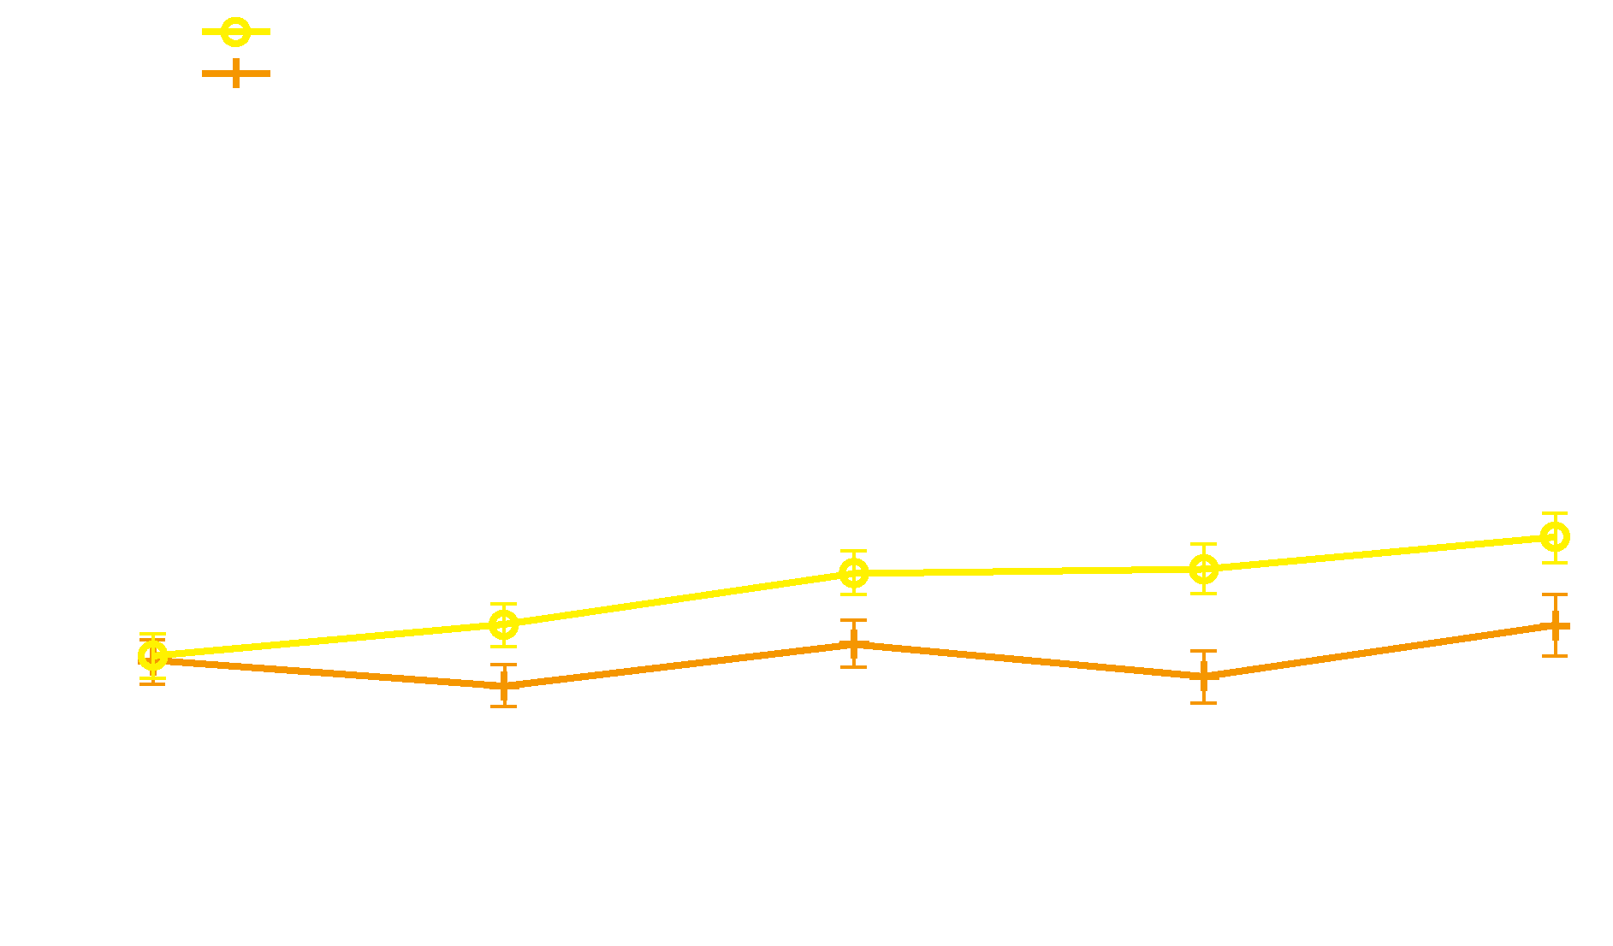
Health-Related Quality of Life
Health-related quality of life improved in the KRd group vs the Rd group over 18 cycles of treatment (P = .0001)
Stewart AK, et al. Blood. 2014;124: Abstract 79.
Notes:
The minimal important difference for between-group differences on the QLQ-C30 Global Health Status/Quality of Life scale is 5 points, which was met at cycle 12 (5.56 points) and approached at cycle 18 (4.81 points)

Slide 23
Conclusions
PFS was significantly improved with KRd (hazard ratio, 0.69; P<.0001)
An unprecedented median PFS of 26.3 months with KRd
Trend in OS favoring the KRd group: Kaplan–Meier 24-month OS rates of 73.3% (KRd) vs 65.0% (Rd)
ORR was higher with KRd (87.1% vs 66.7%); significantly more patients achieved a complete response or better (31.8% vs 9.3%)
Stewart AK, et al. Blood. 2014;124: Abstract 79.

Slide 24
Conclusions (continued)
AEs led to fewer discontinuations in the KRd group, and patients remained on study treatment longer
Cardiac and renal events were reported at rates consistent with or lower than prior studies of
single-agent carfilzomib
KRd consistently improved health-related quality of life compared with Rd over 18 cycles of treatment
KRd represents a potential new standard of care in relapsed MM
Stewart AK, et al. Blood. 2014;124: Abstract 79.

